Slide 1
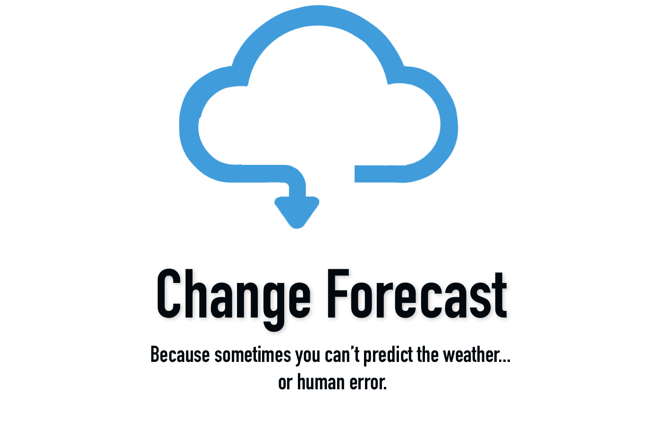
Change Forecast
G Dog and the Coding Ninjas

Slide 2
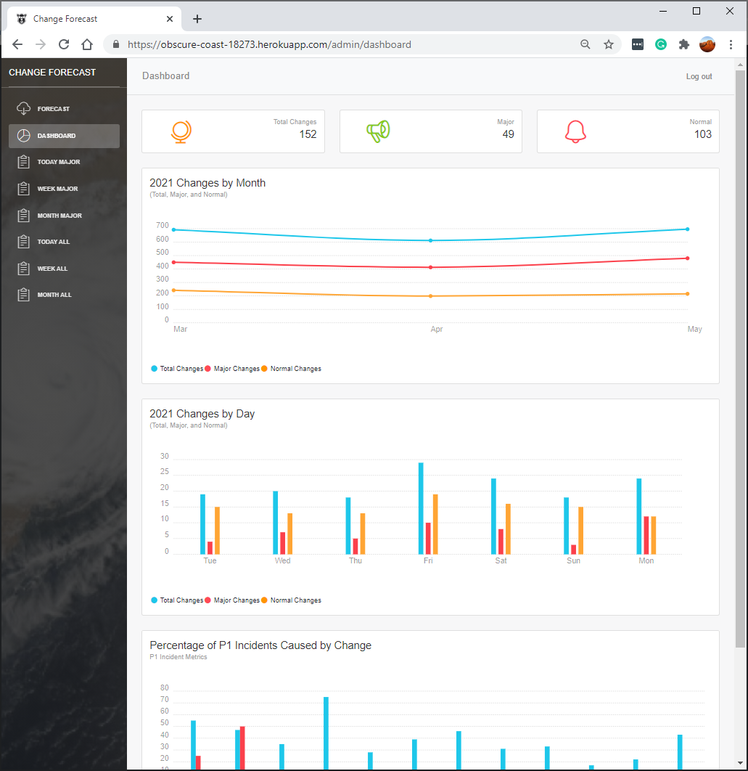
Overview
Introduction
Concept
Demo
Process
Future Development
Links
Questions

Slide 3
Change Forecast in 30 Seconds…
You are responsible for infrastructure stability and you need a quick way to view upcoming major change activity
The answer is Change Forecast
Provides a consolidated view of change data and graphical views
Provides seven-day forecast using weather
Provides data based on current day, week, and 30 days

Slide 4
Concept
Description
Change-forecast is a web tool that is a personal change management assistant that uses API’s to collect change information.
Motivation
There is not a simple tool to quickly gather change request data and present to a user in a clean consolidated format to quickly assess major changes.
User Story
From an existing database within the company environment, change requests have been entered through a series of internal processes. The user has the ability to access that data in a graphical view. The user is provided with the option of viewing the change forecast, dashboard view of changes, or raw change data report.

Slide 5
A Demo of Change Forecast

Slide 6
Process
Technologies
Passport
Axios
Bcryptjs
Chartist – Simple responsive charts
Express/express-session
If-env
Mongodb/mongoose
Mockaroo - Random date generator (database data)
Nucleo – library of over 30, 000 icons
React
HTML/CSS/ Bootstrap
JavaScript
Heroku

Slide 7
Process (continued)
Breakdown of Tasks / Roles
Front-end: Denise, Jerron, Sean, Dexter, Greg
Backend: Donna, Greg, Rich
Issue Tracking and Tasks: Donna, Greg
Project Manager: Greg
PowerPoint: Denise, Dexter
Testing: G Dog and the Coding Ninjas

Slide 8
Process (continued)
Challenges
Authentication for login page
Seed data is needed for an array of objects to make sure React has something to render when it loads
Parameter management in React
Successes
Great teamwork everyone contributed well
Great communication
Productive project meetings
Scrum meeting earlier in the day, followed by a working meeting in the evening
Conducted weekend working meetings
Making a component (not just at the top App layer) a class and leveraging state, component Did Mount within it

Slide 9
Directions for Future Enhancements
Filter changes by user or assignment groups
The ability to choose different date ranges
Search box for searching CI’s for upcoming changes
Integrate past incidents due to a change on a server
Enhanced permissions for change manager
In the reports section allow drilldown on individual tickets
Allow drilldown on the dashboard charts to the changes associated for that day
Allow sort on individual columns

Slide 10
Links
Deployed Application
https://obscure-coast-18273.herokuapp.com/
GitHub Repository
https://github.com/gehanstedt/change-forecast

Slide 11
Questions?

Slide 12
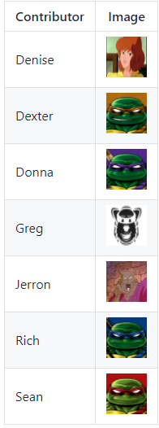
Thank You!

